Slide 1
SQL and Relational Databases
The Data Bootcamp (Supplemental Slides)

Slide 2
What is SQL?
SQL - a programming language for querying data from relational databases
Human readable compared to other programming paradigms
Select statements
Select * from table
* means all columns
from comes before the <table> name
Identify names of columns
Select column1, column2 from <table>
Where clause – filter/conditional
Select column1 from table where column1 >0
Aggregation functions – Average, count, min, max, etc
Group by
Order by
Joins
Left Join
Right Join
Inner Join
Subqueries
in statement
Create, insert, update, delete, drop statements

Slide 3


What is a Relational Database?
Relational Database – A complex software program that is used for the efficient storage and querying of structured data
Relational means Table
Structured data for a database means relational
Schemas – specified format for the table structure
How many columns?
Type of data in each column
Remember we have dealt with tables before
Excel
Pandas
Csv files to some degree

Slide 4
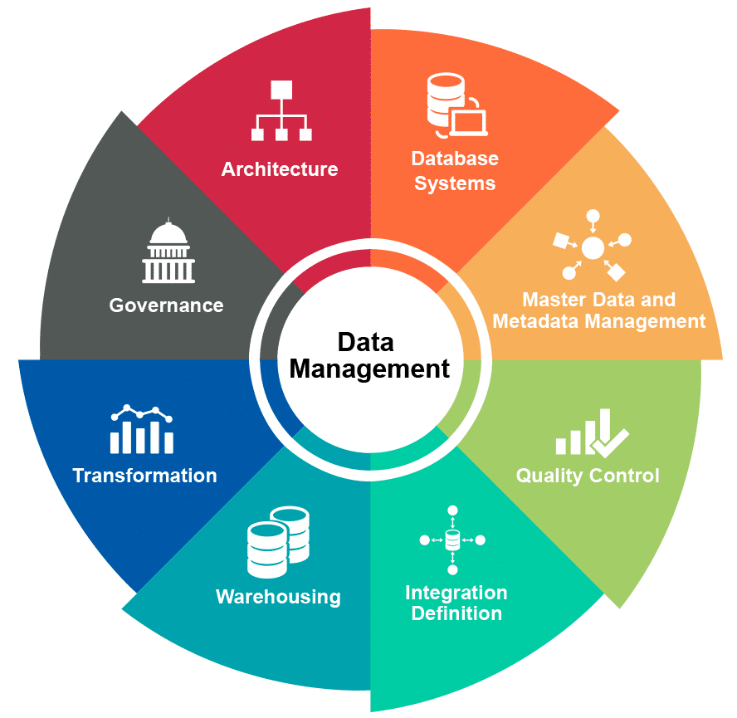
Why do we use relational databases when we have csv files, pandas, and excel?
Relational Database is the de facto standard for the efficient storage and retrieval of structured data
Centralized (Stored in a place where multiple people can work)
Data governance (make rules on data management practices)
SQL
SQL is the de fact standard for the querying of tabular data

Slide 5


Different Types of Relational Databases
Different types of database management systems available on the market
SQLite
MySQL
Oracle
IBM DB2
Netezza
Greenplum
Teradata
Postgres
BigQuery
These systems work largely the same
Understand some flavor of SQL
Similar, but different data types (int vs double vs float – string vs varchar)
Marginal differences that are specific to certain needs
In practice, you will not have the choice of which database you use
That is up to your employer
You will need to adapt and learn the relational database that your uses
Biggest difference is manner in which you connect

Slide 6
Database Connect Workflow
Client
Relational Database
User interface
mySQL Workbench
Driver integrated within
MySQL
User interface
SQL Developer
Driver integrated within
Oracle
Programming language – Command line
Python – Driver – must install/import
Pymysql
Sqlite
cx_Oracle
Also need connection string format
SQLite

Slide 7
Connecting to a Database - Details
Driver – Software that allows you to communicate to a database
Every database manufacturer has it’s own driver
Drivers are different for each programming language
ODBC driver – C-based
JDBC driver – Java-based
Python drivers – pymysql, cx_Oracle, sqlite
Connection String – Format used to specify how to connect to a database
Connection string format differs for each database manufacturer
Connection strings usually include:
Port number
IP address
Username
Password
Manufacturer specific fields
DSN – Oracle
Database – DB2
Mysql – nothing special
SQLite – weird

Slide 8
Final Note on Databases/Drivers
When using a programming language to get data from a database
Multistep process
Connect
Prepare and/or Execute your SQL statement
Fetch – Get your data
Cursor – Concept of looping through database to obtain data via fetch
Commit – Save changes
Use when inserting, updating, or deleting
Not useful when reading

